Slide 1


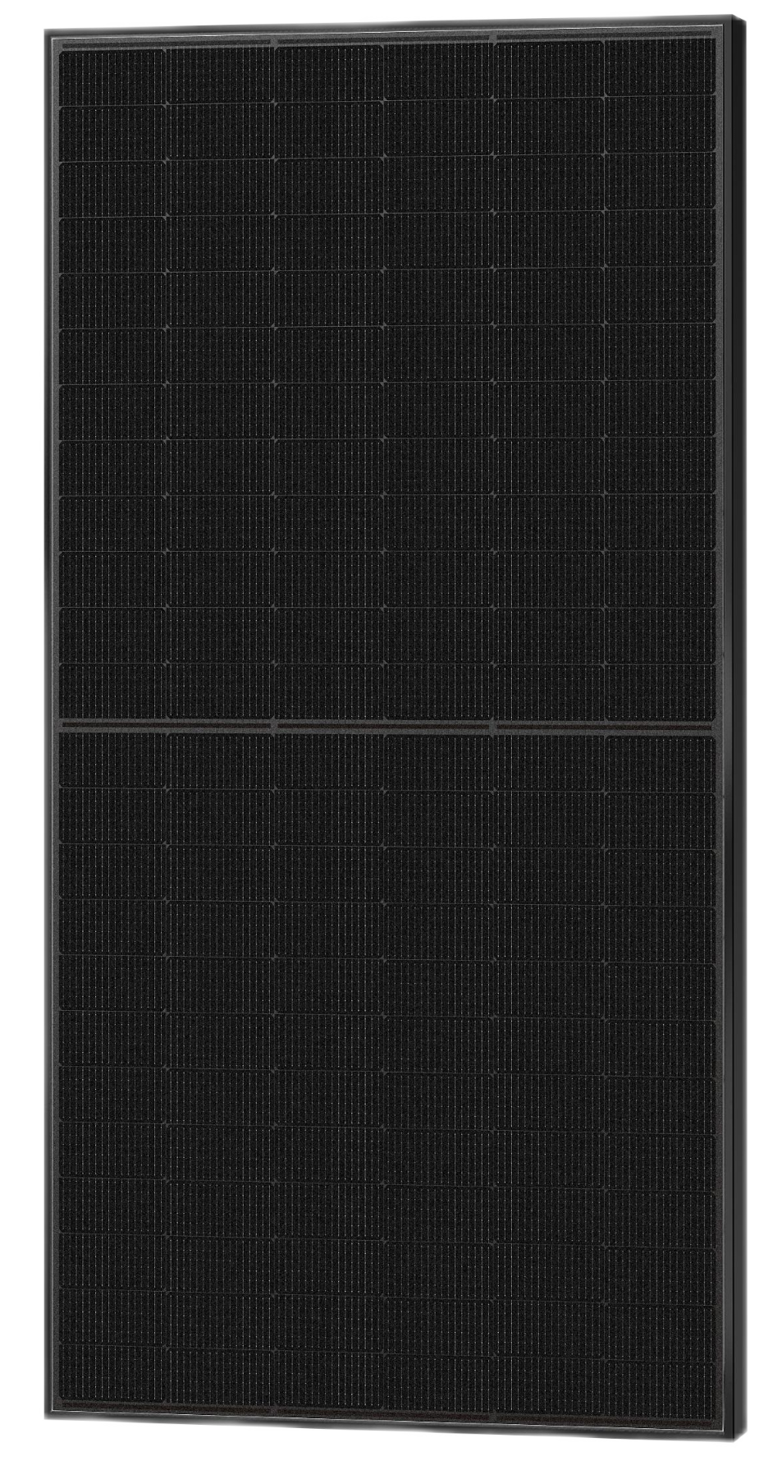
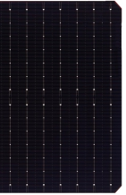
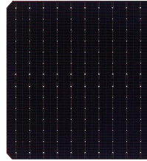








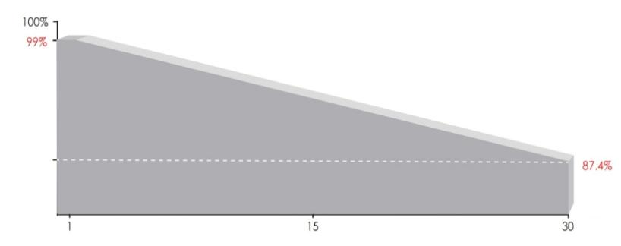
TOPCon N type
Mono-crystalline
630-650Watt full Black
0~+5% POWER TOLERANCE
High efficiency TOPCon N - type solar module
16/18BB
Module characteristics
Strong Mechancial Strength
Passes the wind load test of 2400Pa and the snow load test of 5400Pa
Lower attenuation
N-type，Components have better reliability and lower LID/LETID attenuation
PID resistance
The attenuation probability of PID phenomenon is minimized through solar cell production technology optimization and raw material control
Harsh environmental adaptation
Third party certification for salt spray and ammonnia corrosion tests
Multiple busbar and Half cell technique
More light utilization and current collection capabilities, effectively improving product power output and reliability
Long and reliable quality assurance
30 years material process warranty
30 years power linear warranty
IEC61215(2016), IEC61730(2016) ISO9001:2015: Quality management system ISO14001:2015: Environmental management system ISO45001:2018: Occupational health and safety management system
Power output
Linear decay of 0.4% per year over 30 years
year

Slide 2
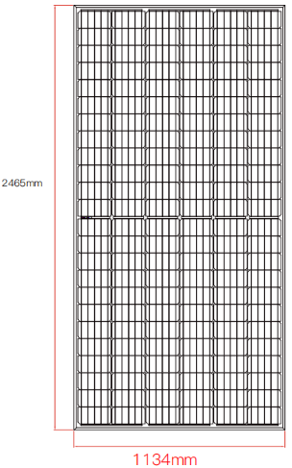
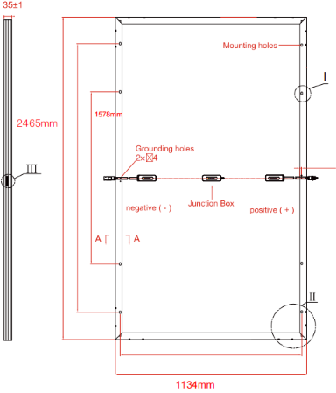
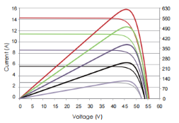
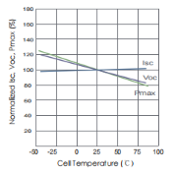
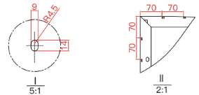
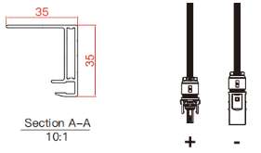
Electrical Parameters
Model Type | ESM-630T |  | ESM-635T |  | ESM-640T |  | ESM-645T |  | ESM-650T
 | STC | NOCT | STC | NOCT | STC | NOCT | STC | NOCT | STC | NOCT
Maximum Power（Pmax） | 630 | 473 | 635 | 477 | 640 | 481 | 645 | 485 | 650 | 489
Open Circuit Voltage（Voc） | 55.93 | 53.12 | 56.08 | 53.27 | 56.23 | 53.42 | 56.38 | 53.57 | 56.53 | 53.72
Short Circuit Current（Isc） | 14.37 | 11.60 | 14.44 | 11.67 | 14.51 | 11.74 | 14.58 | 11.81 | 14.65 | 11.89
MaximumPowerVoltage（Vmp） | 46.06 | 42.83 | 46.18 | 42.95 | 46.28 | 43.05 | 46.38 | 43.15 | 46.48 | 43.25
MaximumPowerCurrent（Imp） | 13.67 | 11.04 | 13.75 | 11.10 | 13.83 | 11.17 | 13.91 | 11.24 | 13.98 | 11.31
ModuleEfficiency - ηm（%） | 22.53 |  | 22.71 |  | 22.89 |  | 23.07 |  | 23.25
Operational Temperature |  | -40℃~+85℃
Maximum System Voltage |  | 1500VDC
Maximum Series Fuse Rating |  | 25A
Power Tolerance |  | 0~+5W
Temperature Coefficient of Pmax |  | -0.360%/℃
Temperature Coefficient of Voc |  | -0.260%/℃
Temperature Coefficient of Isc |  | +0.04%/℃
Nominal Operating Cell Temperature |  | 45±2℃
Safety Class |  | Class II
Max Load（Front/back） |  | 5400Pa/2400Pa
STC: Irradiance 1000W/㎡ Cell temperature 25℃ Atmospheric quality =1.5
NOCT:Irradiance 800W/㎡ Ambient temperature 20℃ Atmospheric quality =1.5 Wind speed 1m/S
Mechanical Diagrams
Curve
Side
Back
Front
Packing Details:
36pcs/pallet
40GP:16 pallets/HQ, 572pcs/40'HQ
Specification
Cell type | N type mono crystalline 182mm
Half-cell quantity | 156pcs（26×6）
Dimension | 2465×1134×30mm
Weight | 31kg±3%
Glass | 3.2mm
Frame | Black Anodized Aluminum Alloy
Junction Box | IP68
Cable | 400mm（can be customized）
EINNOVA SOLARLINE ENERGY CORP. LIMITED
210000 Nanjing
PEOPLE‘S REPUBLIC OF CHINA
TEL：+86-25-8479-2033
Cell: +86-138-13088384
EMAIL : emma.wu@einnova-solarline.com
Website：www.einnova-solarline.com
The company reserves the right of final right of adjustment of this file.

